Slide 1
Salesforce Configuration Model – 1

Slide 2
AGENDA
1. Page layouts
2. List Views
3. Record Types
4. Business Process
5. Queues
6. Global Actions
7. Email Templates
8. Assignment Rules
9. Validation Rules 10. Audit Trail

Slide 3
What is Page Layout
Page layouts control the layout and organization of buttons, fields, s-controls, Visualforce, custom links, and related lists on object record pages.
They also help determine which fields are visible, read only, and required. Use page layouts to customize the content of record pages for your users.
We can create different page layouts for use by different profiles and record types and set field-level security settings to further restrict users’ access to specific fields.
Steps to open Page Layout:
1. From Setup -> click Object Manager.
2. Click ObjectName -> then Page Layouts.

Slide 4
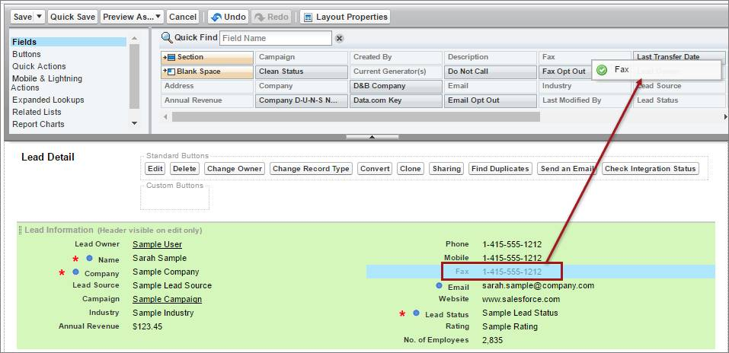
Page Layout

Slide 5
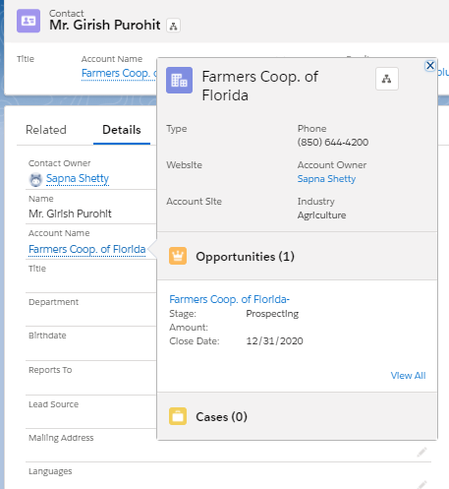
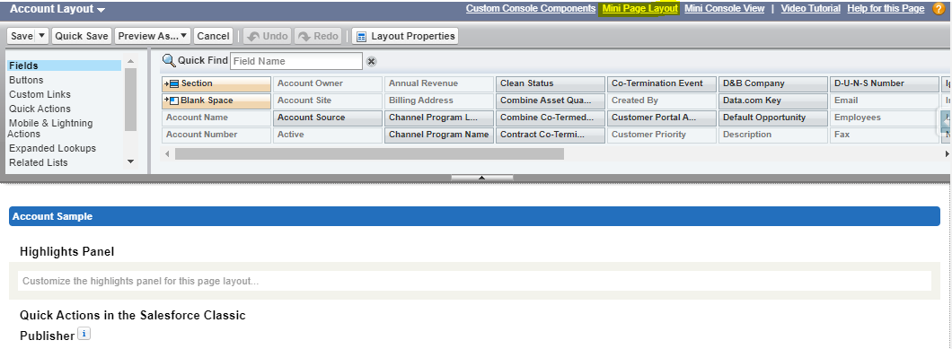
What is Mini Page Layout
The mini page layout defines the hover details that display when you mouse over a field on an object’s detail page. From within a page layout, you can access a mini page layout

Slide 6
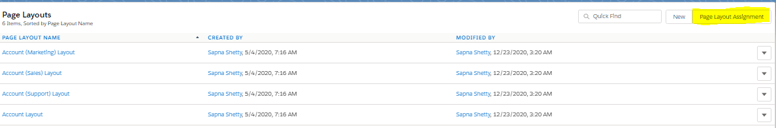
Assign Page Layout to Profiles
In order to view a particular page layout, it must be first assigned to profiles
Steps to assign a Page Layout:
From Setup, click Object Manager | Object Name.
Click Page Layouts, then Page Layout Assignment

Slide 7
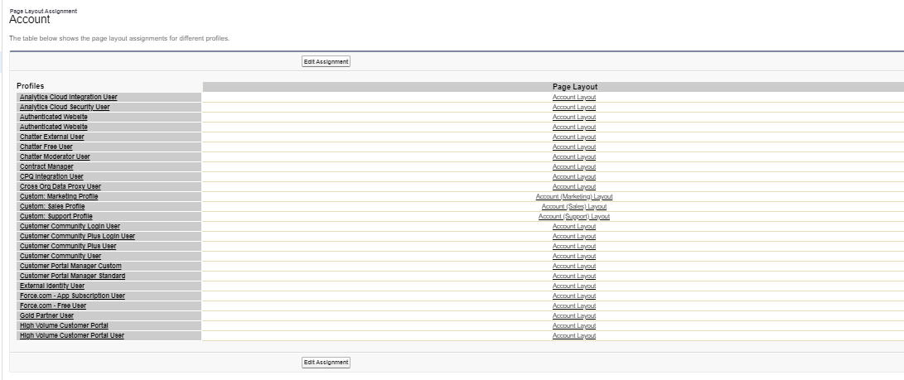
Assign Page Layout to Profiles

Slide 8
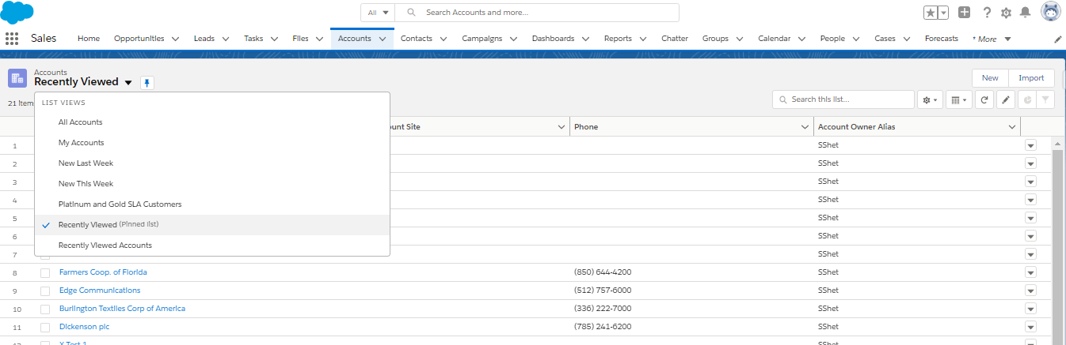
List View
List views are ways of displaying small size of data that are instantly accessible for different Objects
List views are used to quickly segment lists of records, they allow us to action multiple records at the same time.
We can create list views to filter out records based on any field that we have access to. Like You want to see a list of accounts where Billing state/Province =” Ontario” or as per your business requirement.

Slide 9
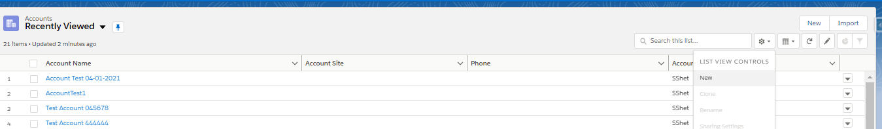
List View
Salesforce provides us with some standard list view but we can also create custom list view based on our requirement.
Steps to create a a new List View
Click on the gear icon on top -> New

Slide 10
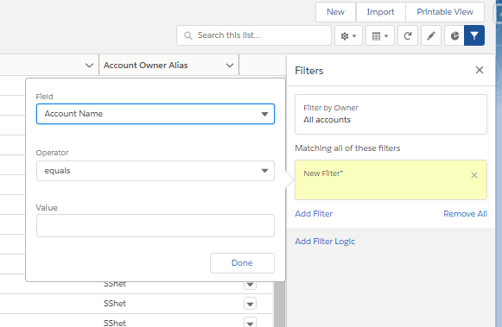
List View
Steps to edit a List View Filters
Click on the gear icon on top -> Edit List Filters

Slide 11
Business Processes
Business Processes allows you to track separate sales, support, and lead lifecycles across different divisions, groups, or markets. Use multiple business processes to display different picklist values for users based on their profile.
Sales Processes : Create different sales processes that include some or all of the picklist values available for the opportunity Stage field.
Lead Processes : Create different lead processes that include some or all of the picklist values available for the Lead Status field.
Support Processes : Create different support processes that include some or all of the picklist values available for the case Status field.
After creating a sales, support, or lead assign the process to a record type. The record type determines the user profiles that are associated with the business process.

Slide 12
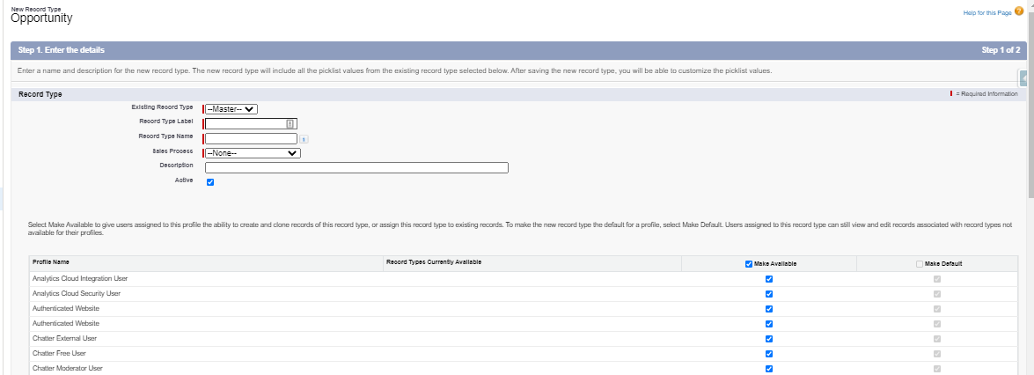
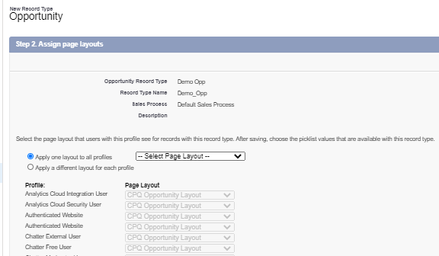
Record Types
Record types let you offer different business processes, picklist values, and page layouts to different users.
You might create record types to differentiate your regular sales deals from your professional services engagements, offering different picklist values for each. Or you might display different page layouts for your customer support cases versus your billing cases.
It is type of field available for all objects in the page layout. Record type will contain all the picklist fields which are created for the object.

Slide 13
Queues
Queues helps us to Prioritize, distribute, and assign records to teams who share workloads. Access queues from list views.
Queue members can jump in to take ownership of any record in a queue. They’re available for cases, leads, orders, custom objects, service contracts, and knowledge article versions.
You can manually add a record to a queue by changing the record’s owner to the queue. Or, an assignment rule can add cases or leads to a queue based on specific record criteria.
Records remain in a queue until they’re assigned an owner. Any queue members or users higher in a role hierarchy can take ownership of records in a queue.
In order to create a new Queue, From Setup-> Queues -> New

Slide 14
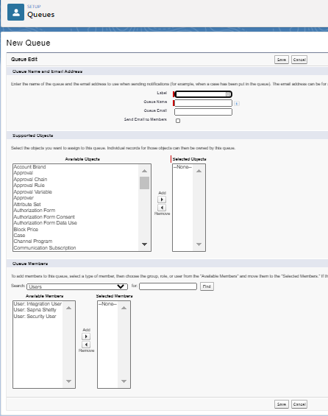
Examples of Queues
Create a lead queue with members who are salespeople assigned to a specific sales territory.
Create a case queue with members who are support agents assigned to different service levels.
Create a knowledge article version queue members who are users that can translate new versions of articles into a specific language.

Slide 15
Global Action
Global actions lets a user perform the following actions without leaving the page they’re on:
Log call details
Create or Update records
Send email
Global create actions enable users to create object records, but the new record has no direct relationship with other records.
Global actions live on a special layout of their own, known as the global publisher layout.
The layout isn’t associated with an object, and it populates the global actions menu in Lightning Experience. Users can access the global actions menu by clicking Global Actions menu icon in the Salesforce header.
After you create an object-specific or global action, you must add it to a page layout or the global publisher layout before it will appear in the Salesforce app.
You can add global quick actions to almost any page that supports actions.
In order to create Global Action, Go to Setup-> Global Actions

Slide 16
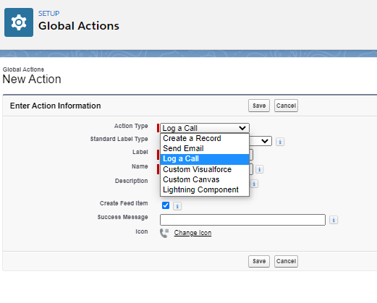
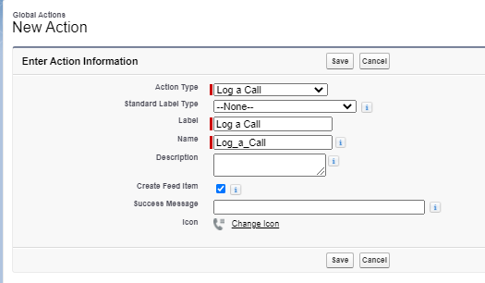
Global Action
For example, add a Log a Call action to global layouts to let users record call details right from a Chatter thread.

Slide 17
Email Templates
Email templates with merge fields let us quickly send emails with predefined email content that include field data from Salesforce records like contacts, leads, or opportunities.
We can use email templates when emailing groups of people—with list email or mass email—or just one person. We use email templates to increase productivity and ensure consistent messaging.
Types of Email Templates:
Lightning Email Templates
Classic Email Templates

Slide 18
Email Templates
Types of Classic email templates:
Text.
HTML (using Classic Letterhead)
Custom (without Classic Letterhead)
Visualforce.
Preview feature in Classic: This feature allows you to have a preview of the HTML body as in how the email content will look like. Note: Option only available in HTML and Custom.
Enable Folders and Enhanced Sharing for Email Templates:
From Setup, enter Email Templates in the Quick Find box, then select Lightning Email Templates.
Enable Folders and Enhanced Sharing.
NOTE: If we disable Folders and Enhanced Sharing for Lightning Email Templates, our reps lose access to the email template folders they created and the email templates inside those folders. To give our reps access again, enable Folders and Enhanced Sharing for Lightning Email Templates.

Slide 19
Assignment Rules
An assignment rule in Salesforce is used to define to whom case or lead is assigned based on the specified criteria. Most of the organizations have one particular rule for the overall purpose.
Lead Assignment Rule:
Automatically assign leads to users or queues based on criteria you define. You can create multiple rules with different conditions, but only one rule can be active at a time.
Case Assignment Rule:
Automatically assign cases to users or queues based on criteria you define. You can create multiple rules, but only one rule can be active at a time.
If no match is found, the item is re-assigned to either the default Web-to-Lead owner, the administrator doing a lead import, or the default case owner.
When ‘Assign using Active Assignment Rule’ checkbox is checked then it will be assigned.

Slide 20
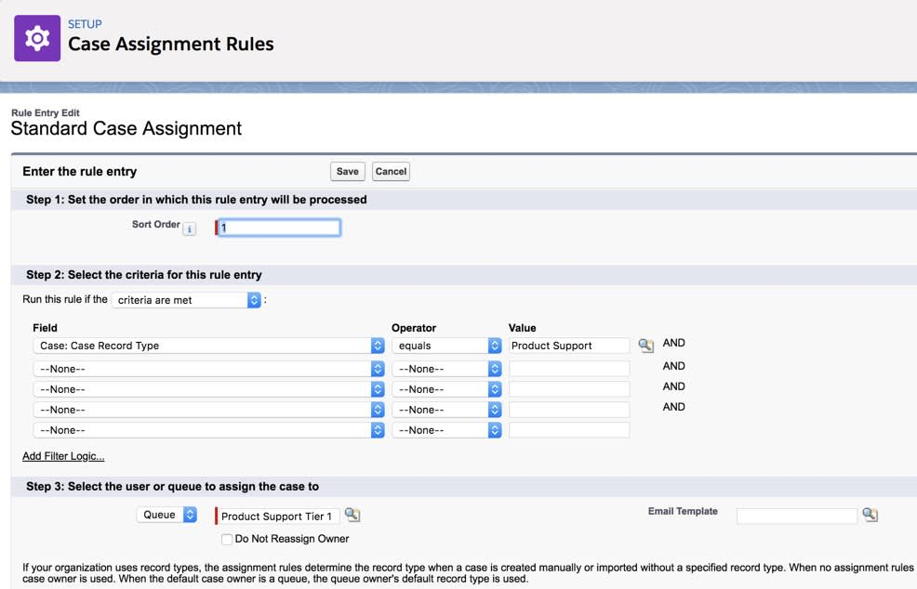
Assignment Rules

Slide 21
Demo
Web-To-Lead

Slide 22
Validation Rules
Validation rules is used to verify that the data a user enters in a record meets the standards you specify before the user can save the record.
A validation rule can contain a formula or expression that evaluates the data in one or more fields and returns a value of “True” or “False”.
Validation rules also include an error message to display to the user when the rule returns a value of “True” due to an invalid value.

Slide 23
Validation Rules
After you have defined validation rules: 1. The user chooses to create a new record or edit an existing record. 2. The user clicks Save. 3. All validation rules are verified. 4. If all data is valid, the record is saved. 5. If any data is invalid, the associated error message displays without saving the record. 6. The user makes the necessary changes and clicks Save again.
You can specify the error message to display when a record fails validation and where to display it.
For example, your error message can be “The close date must occur after today's date.” You can choose to display it near a field or at the top of the page. Like all other error messages, validation rule errors display in red text and are preceded by the word “Error”.

Slide 24
What is Audit Trail
Setup Audit Trail tracks the recent setup and configuration changes that administrators and other users with “Customize Application” access have made to your organisation.
It lists the 20 most recent setup changes by default, and you can download a file with your organisation’s full setup history — up to the last 6 months.
Each entry captures the date and time of the change, the name of the user who made it, and a plain-language description of the action performed.
It’s primarily used to troubleshoot unexpected configuration issues, spot unauthorised changes, and support compliance and security reviews.
Steps to view Setup Audit Trail:
1. From Setup, enter Audit Trail in the Quick Find box. 2. Select View Setup Audit Trail. 3. Click Download to export the full history as a CSV file.

Slide 25
Thank You

